Slide 1
The Power of K NC Kindergarten Teacher Leader Initiative
Eva C. Phillips
Amy S. Scrinzi
NC Department of Public Instruction
Office of Early Learning
Dr. Eva C. Phillips Dr. Amy S. Scrinzi
NC Department of Public Instruction
Office of Early Learning

Slide 2
Agenda
Why K?
Power of K Overview
Planning Structure & Timeline
Purpose & Goals
NC Position Paper
Teacher Leader Initiative
Format and Structure
Timeline
Components
Commitments
Evaluation
Funding
Things to Consider
Successes
In Their Own Words
Next Steps

Slide 3
Why K?
State Board of Education Goal: Future Ready Students
Universal point of entry for children
Provides the foundation for success
Public school credibility highest at kindergarten year
Notes:
Kindergarten Challenges
Lack of consistency
Lack of understanding of effective practices
Implementation of standards balanced with child development
K-2 Retention rates continue to be high goals / expectations / practices
for working with young children
while remaining true to the learning styles and developmental needs of increasingly diverse 5 year olds.
in the early grades
\ Kindergarten Teachers Speak Out
January, 2006 - “K Sharing Day”
50 teachers - regional representation
Administrators & B-K faculty
Purpose
Begin the Conversation
Successes & challenges
Strategies and support systems
Gather data - programs, SCOS, assessment, expectations
Recommendations

Slide 4
Structure & Timeline
Kindergarten Task Force Fall 2006
Data Collection
Recommendations
Workgroup Fall/Spring 2006-2007
State Position Paper
Teacher Leader Initiative
Think Tank Spring 2007- current
On-going Teacher Leader Initiative Planning

Slide 5
Purpose & Goals
Strengthen kindergarten programs in NC
Create strong kindergarten teacher-leaders
By improving teachers' leadership skills
By improving their knowledge and teaching skills and methods
Create and support effective, engaging and appropriate environments for all students
Improve student achievement

Slide 6
Power of K Position Paper

Slide 7
Intended Outcomes
Position Paper
Framework
Consistent, clear expectations & practices
Establish the foundation for 21st Century Learning Skills and Future Ready Students
Strengthen connections
Support NC Ready Schools Initiative
Foundation for K Teacher Leader Initiative

Slide 8
Position Paper
The Mandate
The Power of K
Kindergarten Today
Kindergarten Children Today
Kindergarten Programs of the 21st Century:
Intentional Teaching and Learning (p. 2-3)
Kindergarten Programs of the 21st Century:
The Debate Around Play (p. 3-4)
North Carolina’s Charge

Slide 9
Kindergarten Teacher Leader Initiative

Slide 10
Intended Outcomes
Teacher Leader Initiative
Create a network of highly qualified, kindergarten teachers across all regions of the state
Enhance teachers’ pedagogy and leadership skills
Provide kindergarten programs that promote and build upon the NC Kindergarten Position Statement

Slide 11
Research Says:
High Quality Professional Development that is most likely to positively affect teacher instruction…
Is extended in time, with time built in for practice, coaching, and follow-ups
Has active learning
Is focused on specific content and instructional strategies rather than general
Is embedded within an aligned system and connected to several elements of instruction (assessment, curriculum)
Has collective participation of educators (grade level/school teams)
MCRel Professional Development Analysis, 2005

Slide 12
Teacher Leadership
Teacher leadership is the process by which teachers, individually or collectively, influence their colleagues, principals, and other members of the school communities to improve teaching and learning practices with the aim of increased student learning and achievement.
The Center for Comprehensive School Reform and Improvement September 2005

Slide 13
Teacher Leader Initiative
Three-year comprehensive professional development initiative
By the end of year three, the participants will be recognized as state and local teacher leaders who,
Understand kindergarten students’ development
Integrate child development with standards
Intentionally provide, maintain and advocate for appropriate classroom environments and instructional practices
Articulate appropriate expectations to families, teachers and administrators
Notes:
Kindergarten Transformation

Slide 14
Format
Planning Year
Year 1
Year 2
Year 3

Slide 15
Planning Year
Identified Need/Research
Kindergarten Task Force Meeting
Professional Development Research
Researched PD Initiatives
Researched Teacher Leadership
Built Infrastructure
Pursued Approval & Funding
Established Work Group & Think Tank
Utilized BK Consortium Partnerships
SBE Endorsement of NC Position Paper
Planned Strategically
Based on TEAM Project
Established Outcomes
Mapped 3-Year Goals
Planned Year One
Evaluation
Launched Initiative
Application
Teachers Selected
Planning Year
Year 1
Year 2
Year 3

Slide 16
Teacher Leader Initiative
Application
General Information
Teaching Experience
Questions
5 Mandatory, 1 Optional
3 References
Commitment Signatures
Principal, District Office
Teacher
DPI
Notes:
Kindergarten Transformation

Slide 17
Application
Application Questions | Max. # Pages (double-spaced) | # Points
1. What is your educational background? (Include college experience and certifications, including National Board Certification) What special honors and/or recognitions have you received? | 1 | 10
2. Finish this statement: Kindergarten children learn best when… | 1 | 20
3. Describe a typical day in your kindergarten classroom. | 2 | 20
4. List your leadership roles and/or experiences within the last 5 years. (Professional organizations and community involvement may be included here). | 1 | 10
5. Explain your interest in becoming a Kindergarten Teacher Leader. | 1 | 10
6. Please share any other information that would help the selection committee get to know you as a kindergarten teacher. (OPTIONAL) | 1 | 0
7. Provide 3 letters of recommendation. (1 letter from an administrator, 1 letter from a parent, 1 letter from a colleague) | 3 | 30
TOTAL | 10 | 100

Slide 18
District & Principal Commitment
Approve professional leave for a total of 5 days during each of the 2007-2010 school years.
Approve professional leave (if required) to attend a 4-day July institute during each of the 2007-2010 school years.
Attend a half-day Kindergarten Teacher Leader annual celebration meeting.
Consider using the expertise of the kindergarten teacher leaders as professional resources in order to achieve district and regional goals by offering opportunities to participate with district committees, provide professional development and/or mentor pre-service and ILT teachers.
Consider receiving training on the State Board approved PreK-K Teacher Performance Appraisal Instrument (TPAI), implementing PreK-K TPAI in the Kindergarten Teacher Leader classroom in lieu of the current K-5 TPAI, and incorporating the kindergarten teacher leader goals into the existing school/district Individualized Growth Plan (IGP).

Slide 19
Teacher Commitment
Participate in each Teacher Leader opportunity by maintaining full attendance and participation during each of the 2007-2010 school years.
Work with administration in the implementation of the PreK-K TPAI for all personal observations, identify personal and professional goals, and incorporate these into the existing IGP used by the school/district.
Maintain communication with the school principal regarding the teacher leader project and express interest to the school, district, and/or region regarding membership on committees and/or leading professional development (when applicable).

Slide 20
DPI Project Commitment
Provide current, effective and engaging long-term professional development and high-quality professional materials and resources during each of the 2007-2010 school years.
Provide CEUs for each of the professional development meetings.
Provide financial support:
Teacher stipend for attending each professional development meeting not held on a school day during each of the 2007-2010 school years.
Lodging, food, and travel reimbursement for each summer institute and professional development meeting during each of the 2007-2010 school years.
Substitute reimbursement for each summer institute (if required) and seasonal professional development meetings during the 2007-2010 school years.
Provide ongoing communication to administrators of all teacher leaders, such as PreK-K TPAI training availability.
Provide an annual celebration meeting for teacher leaders with administrators, highlighting growth and successes in each represented district and region.

Slide 21
Teacher Leader Initiative
Application Process
Letter sent to Superintendents, Charter School Directors, K-5 Central Office Administrators
Flyer mailed to all Lead K Teachers at each Elementary School in the state
Application online
January 2 -February 15, 2007
Notes:
Kindergarten Transformation

Slide 22
Teacher Leader Initiative
219 NC K teacher applicants
Diverse review committee: Workgroup
Read by 2 reviewers
Rubric; Consensus
WOWs! And Top Scores
36 NC K teachers were selected
Represent each region of the state
Notes:
Initial plan to include 30

Slide 23
NC State Board of Ed Regions

Slide 24
Regional Groups
Regional Groups
Women of the West
Kinderellas
Capital Ks
Coastal Cuties
Designated Facilitator
Think Tank Members

Slide 25
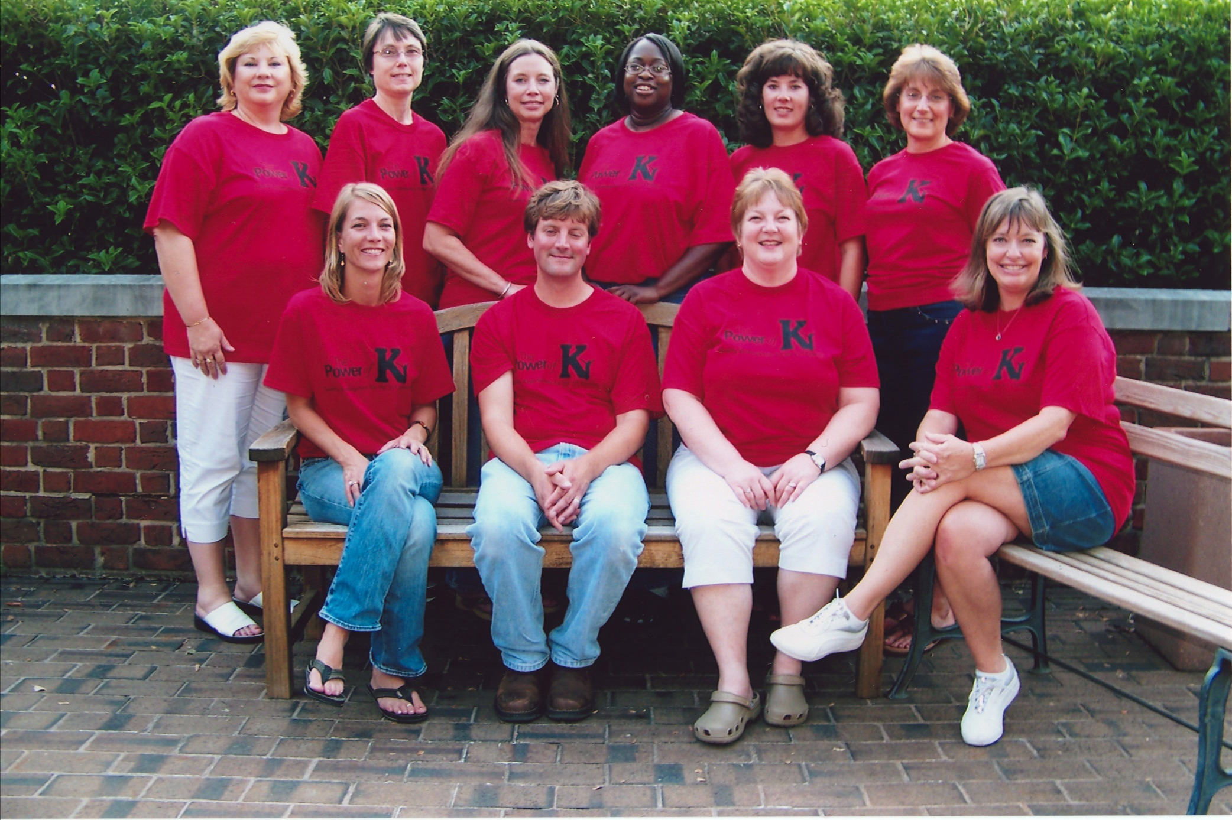
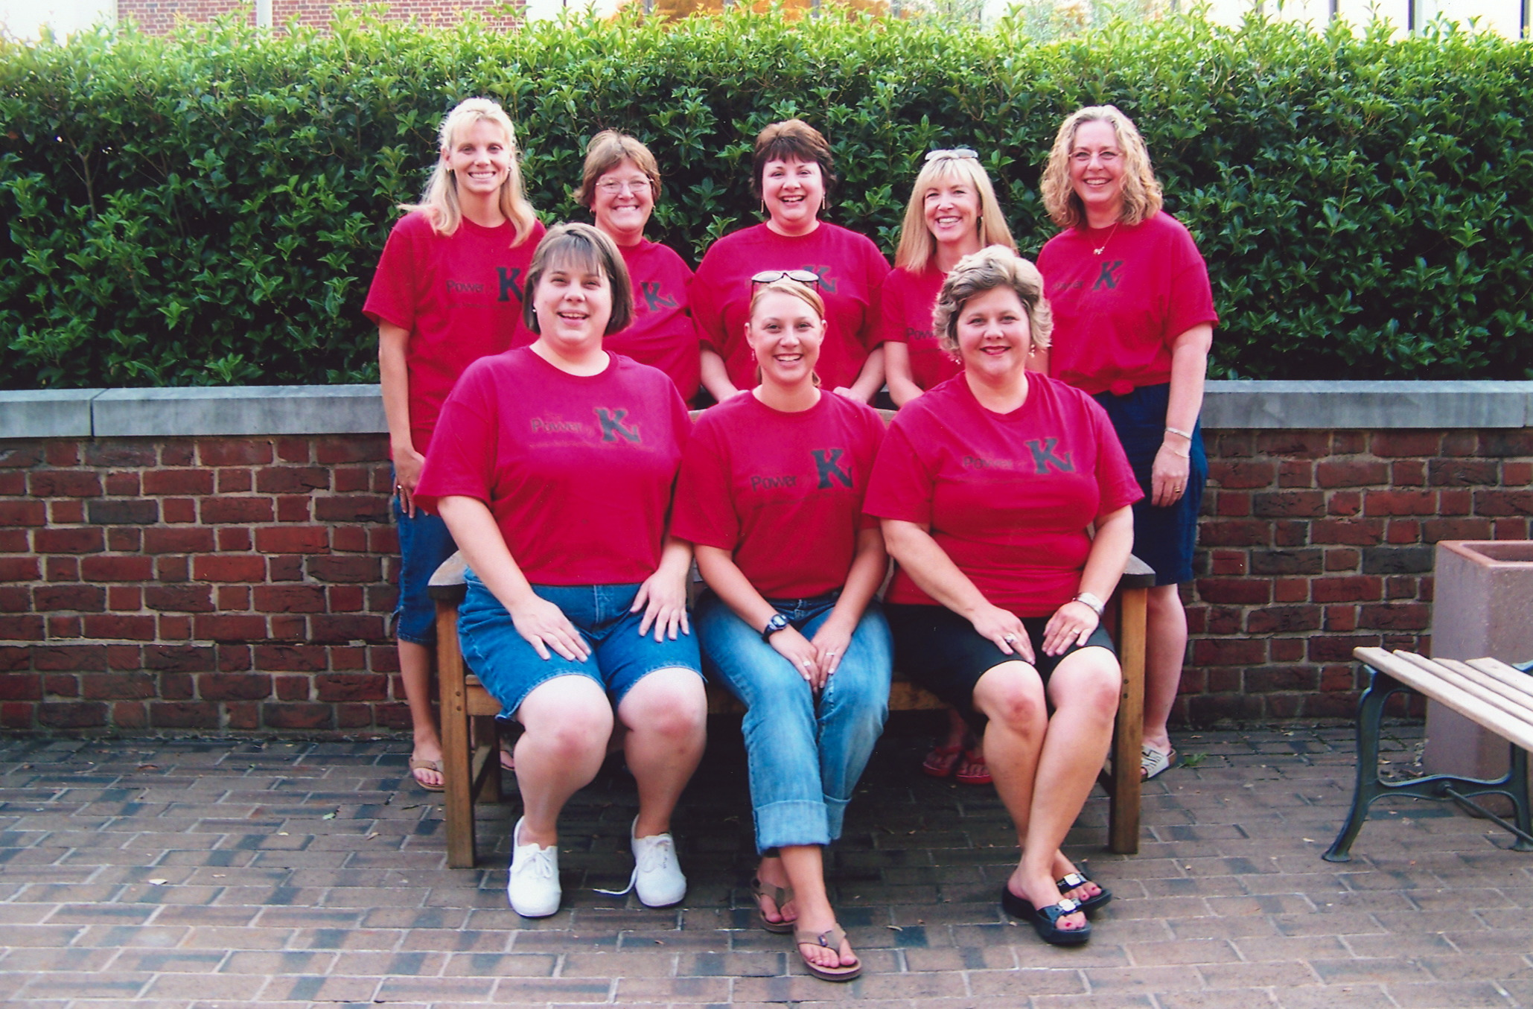
Regional Groups

Slide 26
Timeline
Each of the 3 years included:
Summer Institute (plus a final week beginning of year 4)
3 two-day Seasonal meetings/trainings
Weekdays
Reflection & Practice (Home Learning)
Assessment
Evaluations
Surveys
Participant reflections
FirstSchool Snapshot evaluation (Years 1 & 3)
Math beliefs, content knowledge & practices
Year 3 child literacy scores

Slide 27
Year 1, 2, & 3
Think Tank Meeting(s)
Summer Institute
1-2 days w/ Admin
Think Tank Meeting(s)
Fall PD Meeting
Think Tank Meeting(s)
Winter PD Meeting
Think Tank Meeting(s)
Spring PD Meeting
1-2 days w/Admin

Slide 28
Essential Components
POK
Relationship & Team Building
Teacher Leadership
Content Knowledge
Connections

Slide 29
Components
Relationship & Team Building
Home Visits
Regional Groups
Self- Reflection: journals, True Colors, surveys
Regional Group Projects
Motivational Speakers
Field Trips to classrooms
Celebrations
Good food
Music
Acknowledgements

Slide 30
Components
Content Knowledge
Balance of learning contexts
Presentations by experts
Reflection by teacher leaders
Hands-on Application by teacher leaders
Digging Deeper
Differentiated opportunities
What Do You Believe? (philosophy statements)
Home Learning: Reflection & Practice

Slide 31
Components
Teacher Leadership
Framework
Awakening the Sleeping Giant, Moller/Katzenmeyer
Presentations by experts
Opportunities to practice & develop
Articulation
Documentation of learning
Design & Deliver professional development
Yellow Pages Mini-Sessions
Regional group presentations
NCaeyc
Yearly Goal Setting
Home Learning: Reflection & Practice

Slide 32
Components
Connections
Administrators
Administrators’ Day (Principals & Elementary Coordinators)
Spring Meeting
Summer Institute
Always welcome
Goal Setting with their KTL
Partners & Presenters
IHE’s
State Agencies and Organizations
National experts
Frank Porter Graham Child Development Institute

Slide 33
Year One
Planning Year
Year 1
Year 2
Year 3
Content Focus
Child Development
DAP
Play
Classroom Community
Classroom Environment
Learning Centers
Blocks, Dramatic Play
Alignment w/Pre-K
Leadership Focus
What is a Teacher Leader?
I AM a Teacher Leader
NC Connections
Building Relationships & Teams

Slide 34
Year Two
Content Focus
Literacy
Integration
Learning Centers
Blocks & Dramatic Play
Reading, Writing
Creative Art
Classroom Community
Play
Leadership Focus
More About Me
Types of Leadership
Articulation through Writing & Presenting
Writing Teams
Mini-conferences
NCaeyc Presentations/Participation
Strengthening Relationships & Teams
Planning Year
Year 1
Year 2
Year 3

Slide 35
Year Three
Planning Year
Year 1
Year 2
Year 3
Content Focus
Mathematics
Integration
Learning Centers
Blocks & Dramatic Play
Math & Puzzles/Games
Sand & Water
Project Approach
Social Studies
Science
Classroom Management
Scheduling
Play
Leadership Focus
National Perspective
Using Data to Guide Practices
Leading in Your Own Land
Regional Projects & Planning
Sustaining Relationships & Teams

Slide 36
Strands
Power of K
Articulation
Intentionality
Advocacy

Slide 37
Evaluation

Slide 38
Evaluation
The FirstSchool Academic Snapshot (Ritchie, Weiser, Kraft-Sayre, Mason, Crawford, & Howes, 2010)
Reliable and valid tool used in many national and state studies.
Time sampling method
Captures children’s experiences on a minute by minute basis to provide a ‘snapshot’ of a child’s day
amount of time children spend in specific activity settings and academic activities
teacher instructional strategies

Slide 39
Evaluation
The FirstSchool Academic Snapshot (Ritchie, Weiser, Kraft-Sayre, Mason, Crawford, & Howes, 2010)
Data
Activity Settings
Child Engagement
Child Behavior
Literacy Composite
Teacher-Child Engagement
Math Composite

Slide 40
Evaluation
The FirstSchool Academic Snapshot (Ritchie, Weiser, Kraft-Sayre, Mason, Crawford, & Howes, 2010)
Data were used to:
Engage teachers, principals and central office personnel in discussions about how research data can impact classroom practice
Inform professional development plans
Inform teacher goal setting
Access to individual data
Shared with teachers in individual conferences

Slide 41
Classroom Practices Data

Slide 42
Classroom Practices Data

Slide 43
Classroom Practices Data

Slide 44
Classroom Practices Data

Slide 45
POK & Mathematics 2009

Slide 46
POK & Mathematics 2009

Slide 47
POK & Mathematics 2009

Slide 48
POK Mathematics 2009

Slide 49
Leadership Data
End of Year Survey
Gained…
Confidence
Ability to articulate philosophy and practices
Ability to articulate research justification
Willingness to try new things
Listening skills

Slide 50
Leadership Data
End of Year Survey
Increase in Leadership Roles
Grade level chair
Leadership Team rep
Mentor
Cooperating Teacher
Led in-service sessions
Families
Teachers/School
District
College/University
State Associations/Organizations

Slide 51
Survey: KTL Thoughts
“I realized that you don’t have to have any kind of title to be a leader.”
I have become more confident in my own practice and in articulating to others my reasons for teaching the way I do.”
“Because I am a “POK” person, I am viewed as the ‘go-to’ person for most issues regarding K.”
“I have willingly moved into leadership roles within my district rather than limiting myself to school leadership roles.”

Slide 52
Survey: KTL Thoughts
“More courage and confidence came with the conviction of knowing what is right.”
“My administrator trusts me completely to make great decisions for my students and the other students in kindergarten as well.”
“I seek opportunities to lead or to become a part of a group which may create change.”
For me, leadership requires confidence, competence, and communication skills. All three of these “c”s have been developed in me this year.”

Slide 53
Funding

Slide 54
Funding
NC Department of Public Instruction: Pledged efforts- Time and Money
State Superintendent
State Board of Education
Title 1 Division
Curriculum & Instruction Division: Primary Team
Office of Early Learning

Slide 55
Funding
Funding Sources:
Year 1-2 = Title I and Title II monies
Year 3 = Title I monies only
Expenditures
Co-leaders
travel reimbursements (Home Visits, PD Training)
Teachers & Think Tank
stipends
travel reimbursements
substitute reimbursements
NCaeyc membership & conference registration (Years 1-2)
Resources & materials
Presenter contracts
Meeting/Institute contracts

Slide 56
Funding
Grand totals
Year 1 = $149,000 (65% Title I)
Year 2 = $179,000 (65% Title I)
Year 3 = $111,000 (100% Title I)

Slide 57
Things to Consider

Slide 58
Things to Consider
Leadership
Broader Inclusion and Focus
Central Office Staff
School Principal
School Coaches
Deeper Focus
Kindergarten Best Practices
How to cultivate & nurture teacher leadership
Cross school collaborative community
Clearer Expectations/Commitment
Personal Participation
District mandated expectations
Misaligned beliefs/practices within school/district

Slide 59
Things to Consider
Participation
Reach more teachers
Applicants not selected
Inclusion of preschool & first grade
Inclusion of classroom assistants
State/National Organizations
Where does Kindergarten “Fit”?
Expansion into multiple associations/organizations

Slide 60
Things to Consider
Sustainability
Length of initiative
3 years not enough!
Could’ve been 10! ☺
Coaching opportunities b/t PD meetings
Contradictory beliefs b/t initiative & school/district
Preaching in your own land

Slide 61
Things to Consider
Variability among Teacher Participation
Dedication, Commitment
Turnover
Babies, moving, illness, new jobs (coach, admin)
Grade Level change
Strength
Varying levels of development
Notes:
Those who are strong/exhibiting growth; those who hinder

Slide 62
Things to Consider
Adult Learning Practices
Who’s Doing the Talking?
Who’s Doing the Thinking?

Slide 63
Things to Consider
Evaluation
Preliminary Data/ Baseline data
In-depth
Long Term
Tied to Student Outcomes

Slide 64
Successes
We are most proud of…
Community that has been created
Relationships formed
Connections & Collaborations
Based on Research
Reflection
Accomplishments & Empowerment of teachers
Impact across the state…bringing the voice of appropriate practices back to K

Slide 65
Successes
Community
Home visits
Smaller teams within large group
4 regional groups with facilitator
Teachers ARE professionals
Stipend
Mutual Respect
Relationships
Intentional Team Building
Safe, nurturing environment
Our personal style: friendly, inviting, safe
Pampering
True partnerships

Slide 67
Successes
Connections & Collaborations
BK Consortium
FirstSchool / FPG
NAEYC / NCaeyc
Think Tank
Teachers
Administrators
University
State Consultants
Notes:
Added credibility, added sustainability

Slide 68
Successes
Based on Research and Data
Development of Initiative:
NC Power of K State Position Paper
Teacher Leader Initiative
Meaningful Content
National & Local Experts
Professional resources
Initiative Data (Snapshot, surveys, questionnaires, homework, discussions, projects, etc.)
Used to set personal goals
Guide PD and topics of focus

Slide 69
Successes
Reflective Process
Journals
Regional Reflection Groups
Evaluation Forms
Feedback
Think Tank Reflection Meetings
Small group feedback
Facilitator guidance
Teaching Philosophy Statements
Home Learning
Regional Blogs

Slide 70
Successes
Teacher Accomplishments
Presentations
State & Local district workshop presenter
National conference presenter
Leadership
NCaeyc
board members
local affiliate members
POK Day
Participation in state-level committees
NC Ready Schools Team member
Mentor
Cooperating Teacher
Book study & PLC leader
Participation in State Level Committees

Slide 71
Successes
Teacher Accomplishments
State Publications
Honors & Awards
Grant awards
Teacher of the Year
National Board Certification
Newspaper & Magazine Features
Certification/Degrees
National Board Certification
Master’s Degree
Administrator Certification

Slide 72
Successes
Life-Changing Experience:
In their words…

Slide 73
Yolanda Sawyer, POK Teacher

Slide 74
Next Steps
POK Phase II
Strategic Planning
Demonstration Classrooms
Continued connections
FirstSchool
NCaeyc
Regional Group Networks
POK Phase III
New Co-hort of teachers

Slide 75
Questions?

Slide 76
Thank You!
POK Think Tank
Sharon Ritchie, FPG Senior Scientist
Sherry Willis, Elementary principal
Dan Tetreault, DPI consultant
Kathy Miller, K teacher
Marylee Sease, K teacher
Emilie MacDonald, K teacher
Susan Choplin, K teacher
BK Consortium
Jeane Joyner, Meredith College
NC Department of Public Instruction
Notes:
Work closely with a group of 66 highly qualified elementary mathematics teachers to build a statewide network of leaders among the ranks of mathematics teachers
Pledged their efforts to the five-year project and have demonstrated an extensive commitment to the project's goals and to meeting its lengthy schedule of professional development and activities

